Slide 1
Virtual Reality
-Dr. Panchali Datta Choudhury
Assistant Professor
CS DEPT.

Slide 2
What is virtual reality?
Virtual reality is a fully immersive computer simulated technology generated with the help of realistic images sound and other sensations that gives the user a feeling of being in a different environment instead of the actual environment

Slide 3
What is virtual reality?
To experience virtual reality, users need a virtual reality headset that generates realistic images and 3D surround sound effects
The main goal of virtual reality is to replace the actual reality with a computer generated virtual environment and this reality could be in the form of a game, video, or some virtual applications

Slide 4
Types of VR headsets
There are two types of virtual headset using which user can experience virtual reality
In the first type of VR headset you have to put your Smartphone inside a cardboard or a plastic case
For example
Google Cardboard
Samsung Gear VR
Google Daydream

Slide 5
Types of VR headsets
In the second type of VR headset the user do not need a Smartphone as all the necessary components are built-in inside the VR headset
These VR headset consists of a screen, some sensors and lenses which help in tracking the user’s head position
Examples
Oculus Rift
HTC vive
Sony Morpheus (Sony Play station VR)

Slide 6
Contd..
Both these VR headsets consists of a pair of lenses which allow the users to view stereoscopic images
Stereoscopic images is a technique that gives 3 dimensional effects or 3D effects to an image
It adds illusion of depth to a flat image

Slide 7
Requirements
The main sensors used in this VR headset are
Magnetometer
Accelerometer
Gyroscope sensor
These sensors help to measure motion and direction in 3D space

Slide 8
Requirements
A magnetometer sensor measures magnetic field, it acts like a compass and generally used to detect the magnetic north and the south position
Accelerometer sensor measures changes in x, y and z axis of Smartphone, the accelerometer detects whether your Smartphone is in landscape mode or portrait mode
For experiencing virtual reality, your Smartphone should always be in the landscape mode

Slide 9
Requirements contd..
A gyroscope sensor is an advance form of accelerometer sensor which measures very small changes in the Smartphone positions,
i.e. when you tilt your phone there will be changes in the position of the phone and these small changes are accurately measured by the gyroscope sensor
The gyroscope sensor is one of the most important sensors in VR because it is with the help of gyroscope sensors the head tracking takes place

Slide 10
Oculus rift consisted of accelerometer sensors, gyroscope and optical lenses and Oculus rift was very expensive
Then Google launched Google Cardboard, so users required to have either a Smartphone or iPhone as these phones already have the necessary sensors built-in
It is because of Google Cardboard VR became popular among the masses
In Oculus rift, you need to connect the VR headset to high specification computer device which is again costly

Slide 11
With Google cardboard, you need an android Smartphone or iPhone that can be inserted inside it
In VR your brain is tricked into thinking that the artificial reality is the actual reality

Slide 12
Differences between VR and AR
Virtual reality completely replaces your actual reality with artificial reality
Augmented reality adds up virtual objects inside your actual real world environment
For experiencing virtual reality you need a head-mounted device which will embrace you completely inside a virtual world
Augmented reality can be experienced just with the help of an Android Smartphone or an iPhone other than Android Smartphone and the iPhone users can also use head’s up display like HoloLens and Meta2

Slide 13
Difference between AR and VR
For experiencing augmented reality camera is required, for virtual reality camera is not required
Examples of VR head mounted displays include the Oculus Rift, HTC vibe, Google cardboard, Samsung Gear VR, Sony PlayStation VR
Examples of augmented reality heads up displays, including the Hololens and the Meta 2

Slide 14
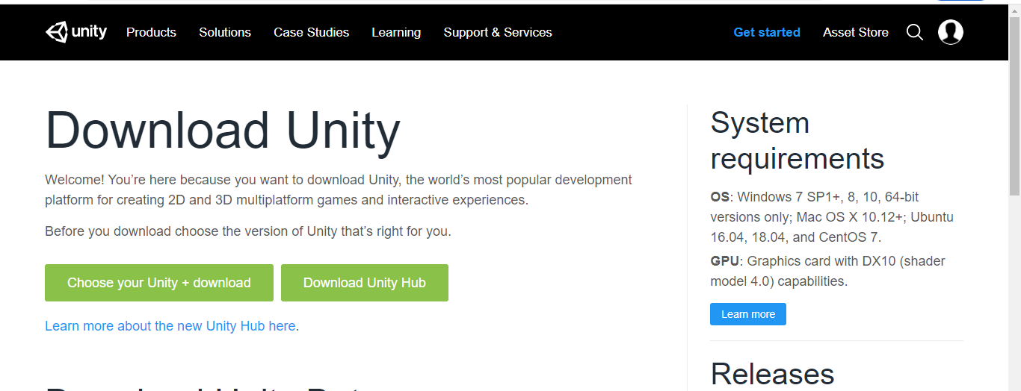
How to download Unity
Go to google and type unity hub download
Go to unity3d.com/get-unity/downloads

Slide 15
Download unity hub software
Once it is completely downloaded copy it to your Desktop
Now double click the unity hub setup file
Agree to Unity’s terms and conditions
Don’t make any changes in the destination folders
It will be installed in C program files folder
Click on the install button

Slide 16
Now once you finished installing the unity hub software if the run is checked it will open in the system automatically
After installing Unity Hub software you can install the latest unity version or 2019 version from the Unity Hub
Click the installs option
Click add and add the version

Slide 17
Instead of installing the alpha or beta versions install the final versions (one with ‘f’ at the end)
Click on next
Select the modules along with unity
Microsoft visual studio community (coding editor that we will be using along with unity )
Android build support (with help of which we can build a unity application and test them on an android Smartphone)
Android sdk and ndk tools
Higher versions of unity check OpenJDK option
Vuforia augmented reality support

Slide 18
Click on next agree terms and conditions
Click on done and installation will start
It might take long depending on Internet speed
Once it is fully installed, you need to activate the unity software

Slide 19
Managing License
Click manage license which is at the bottom
Click login
Create unity id
Enter email
Password
Fullname
Agree terms
Create unity id button
An email will come

Slide 20
Click login in
Enter unity email password
Click activate new license
Unity personal (free)
Select I don’t use unity in professional capacity

Slide 21
THANK YOU

